Slide 1

Final Project Presentation
.NET programming using C#
Instructor: Nital Shah
By:
Mohpreet Kaur (200448160)
Maitra Patel (200449121)
Kaushal Virani (200449270)

Slide 2

GETTING STARTED WHAT ARE WE LOOKING AT?
Purpose of the Application
Idea and Design
Step by Step Demonstration
Outcomes (i.e, our Live Application)
References

Slide 3

PURPOSE OF THE APPLICATION
The purpose of this application to manage the list of books available in Library.
This application has functionality to Create a record for a book, Read, Edit, and Delete record that is saved in a Database.

Slide 4

IDEA AND DESIGN
The idea of this application is derived from the official tutorial provided by Microsoft to create ASP.Net Core Web Application.
It uses Visual Studio as the IDE to create this application.
The design is the basic layout provided by the automatic templates in the Visual Studio as well as our CSS styles.
But, some of the designs have been included to suite the functionality of this new app.

Slide 5
Let’s Start the Demonstration to create the Web Application

Slide 6

STEP I
The first thing is to create a new project in Visual Studio.
We are using ASP.Net Core 2.1 for creating this project.

Slide 7
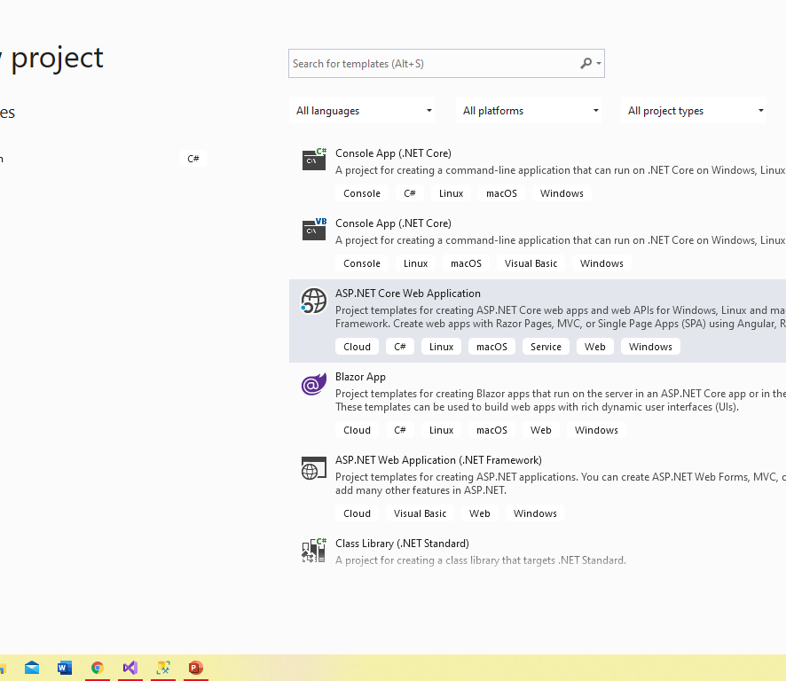
Select ASP.Net Core Web Application

Slide 8
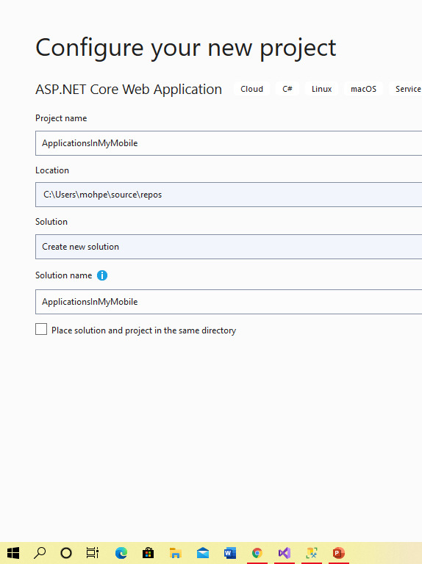
Name our project and click Create
LibraryManagementSystem

Slide 9
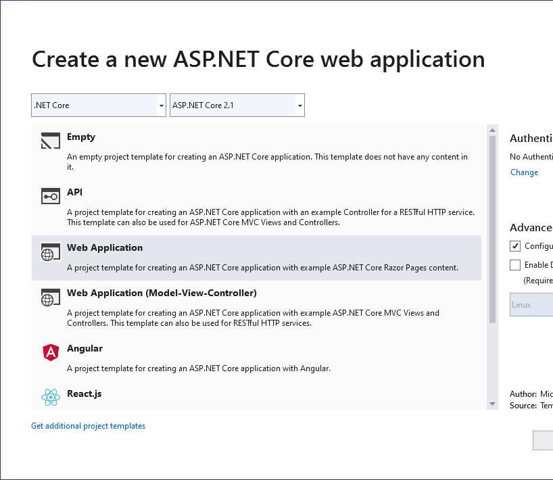
Choose Web Application to get a template with Razor Pages and basic project structure.

Slide 10
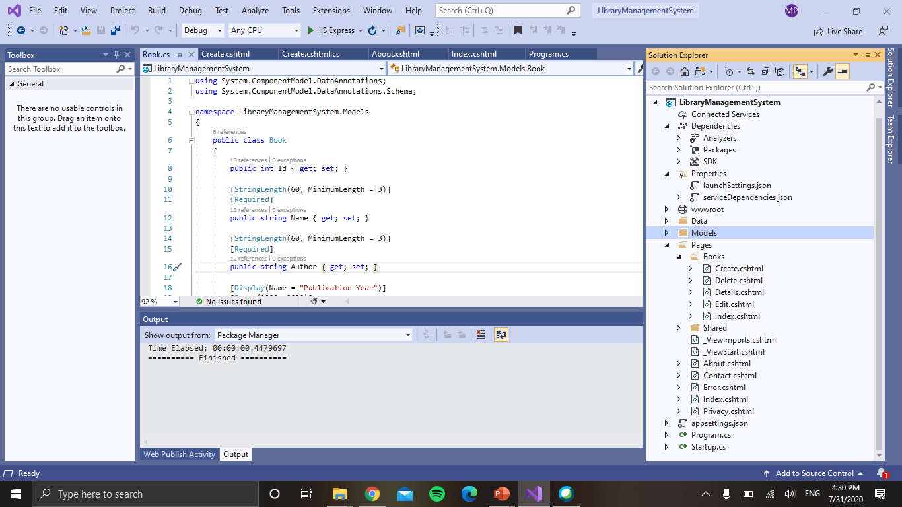
After creating the application, We had all the razor pages required for running the application.

Slide 11

Output on our LocalHost

Slide 12
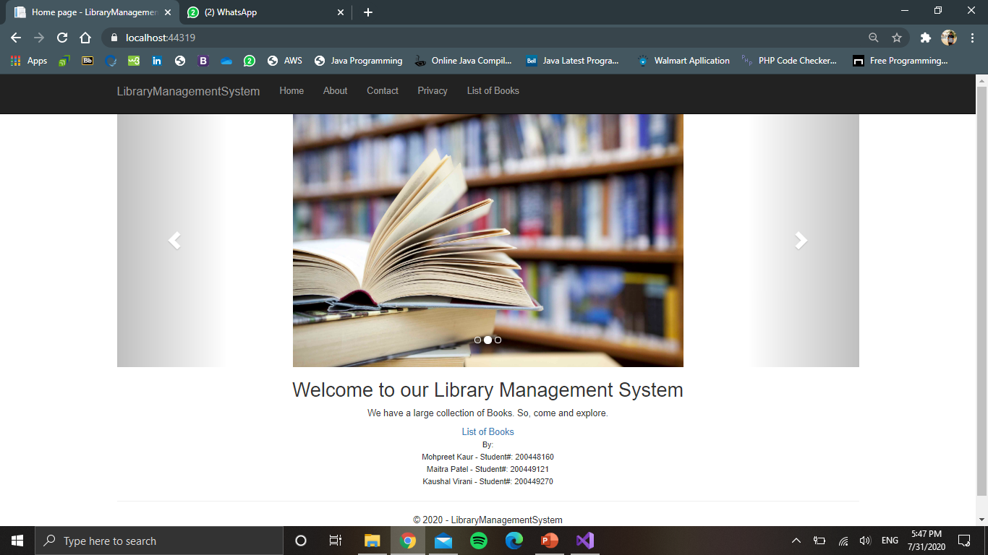

Slide 13
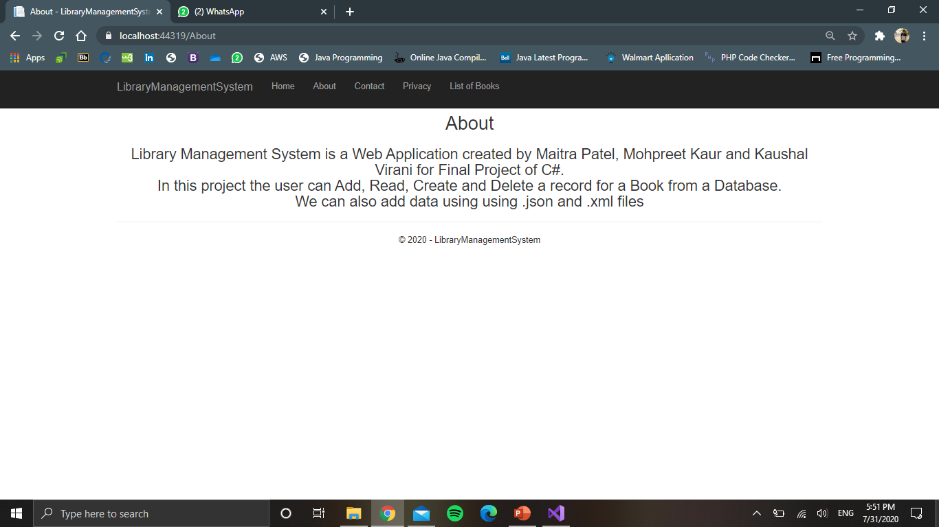

Slide 14
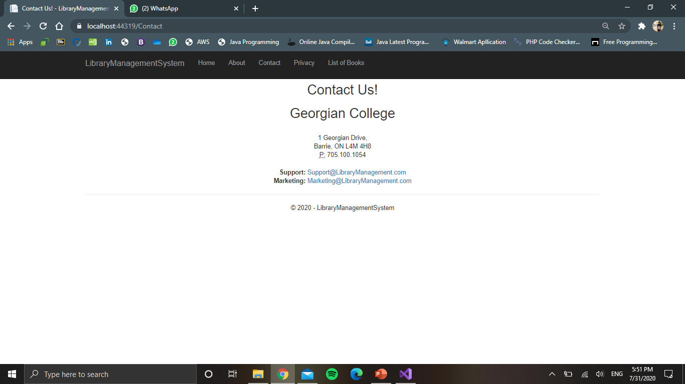

Slide 15
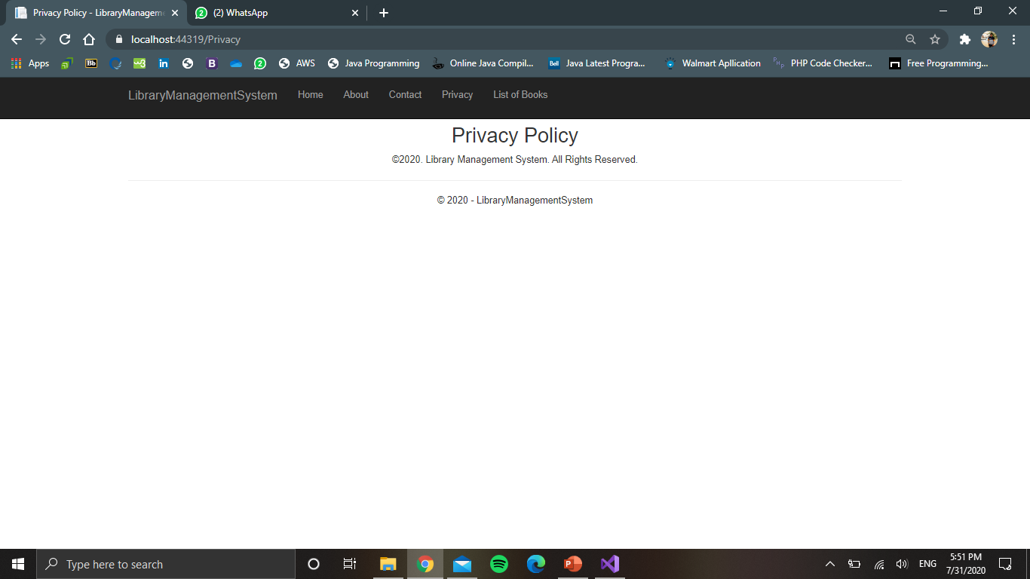

Slide 16
STEP II
The next step is adding an object to the Application and getting pages for CRUD operation on our data.
We will store all our Object classes in a folder called Models and our CRUD files in a folder called Applications.
The Books folder is created inside Pages

Slide 17
Now we add a class to Models folder that carry the blueprint of Book object.
The class we just created serves as the base for our pages for CRUD.
So, we add a scaffolded item to the Books folder, select razor Pages using Entity Framework(CRUD) and choose Book class as our base class.
At this time, we do not have a Data context, so we click on +, create it and add the item.
The scaffolding operation adds some code to Startup.cs and appsettings.json to add connection strings to the code.
Now, we add some code in Program.cs to automatically create a database to store the data entered by the user. This code is as follows:

Slide 18
Quick look at where we are:
Currently, we can add a Book to the database, edit it’s details, see it’s detail and delete it.
However, all of this functionality is accessible only locally.
So, now we will deploy this app to Azure Server to access it over the internet.
This requires us to create a new Azure Account for free.
Then, we publish this app to Azure server.

Slide 19
Output on our LocalHost after Adding CRUD Functionality

Slide 20
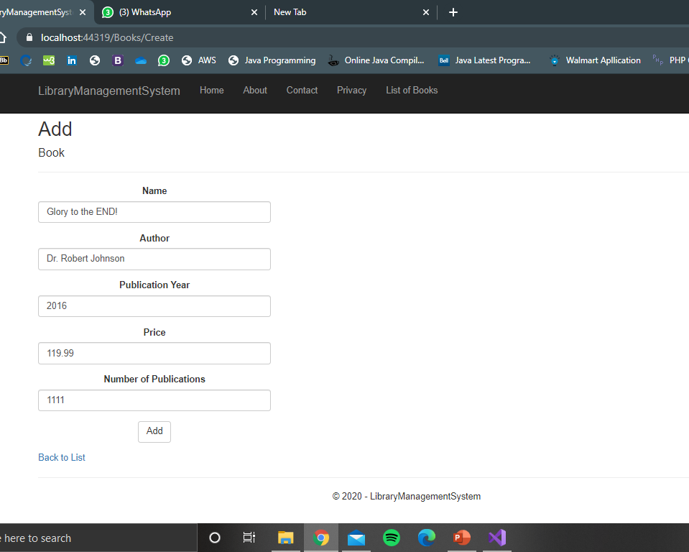
Add a Book to our record

Slide 21
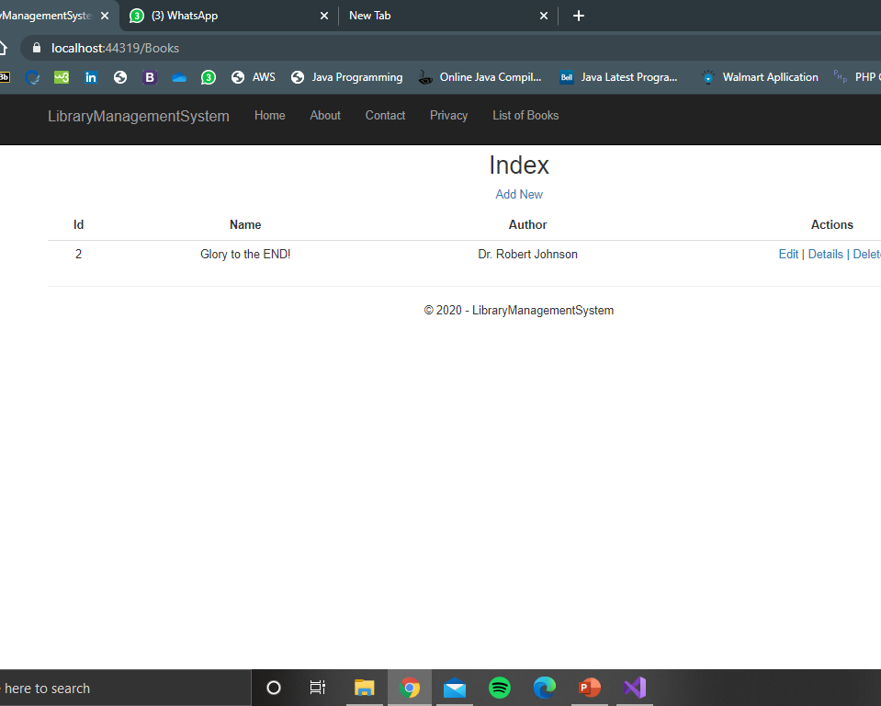
Saved Records

Slide 22
STEP III-
To deploy the app to Azure, right click on the project name and click publish.
Here, you will be asked to create a new Azure Account.
Leave all the settings to default and create the Azure Resource Group. (All the names will be prompted automatically. You can change them if you want.)
After creating the App Service, you will click on Publish.
As soon as the App is published, it opens in a new window in the browser.

Slide 23
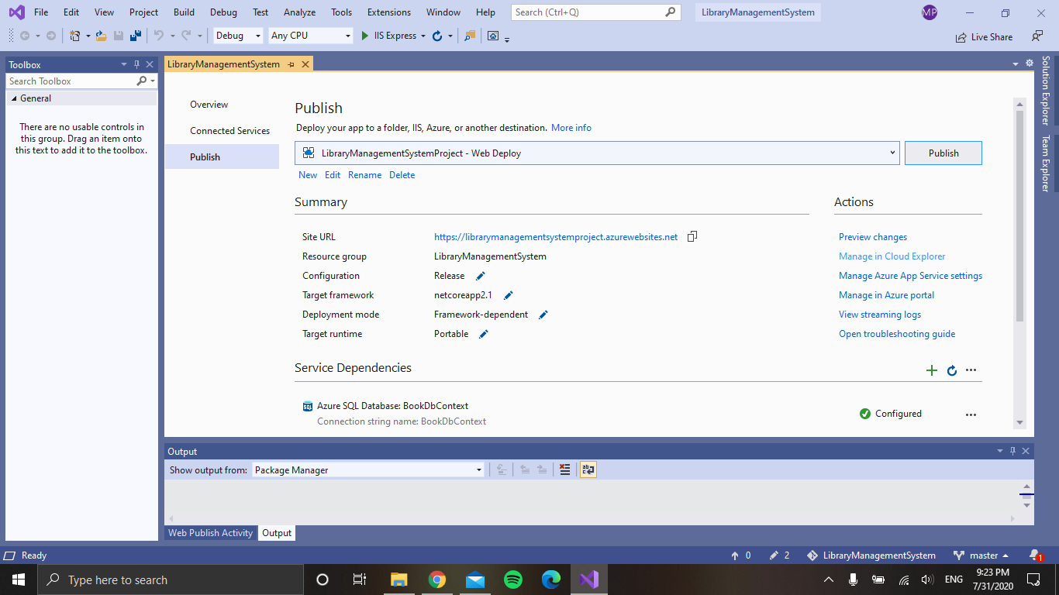
Publishing the Web Application on Azure
Hit to Publish
Link of Web Application
Connected Database

Slide 24
Let’s have a Look to our Live Application

Slide 25
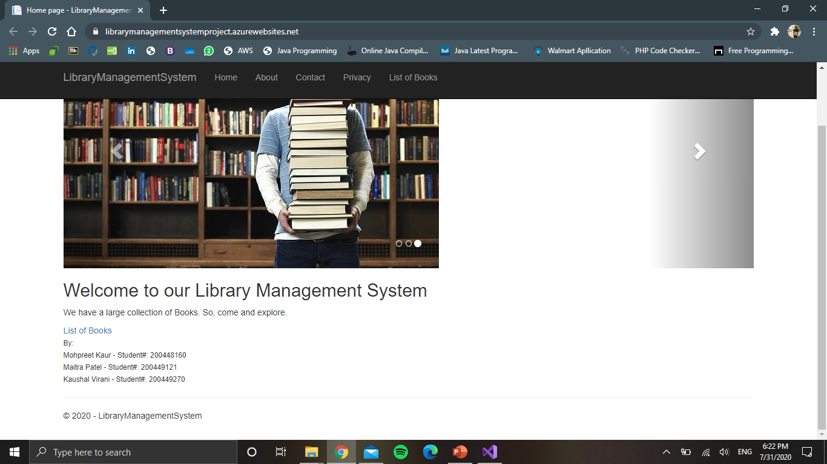
Home Page

Slide 26
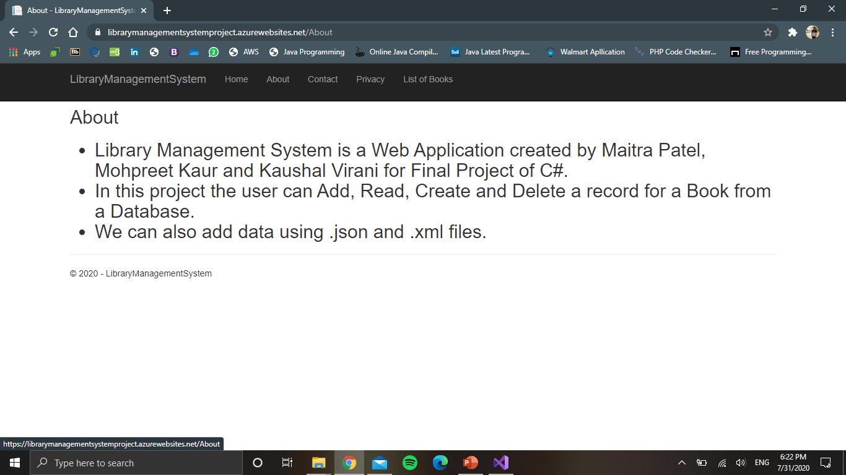
About Page

Slide 27
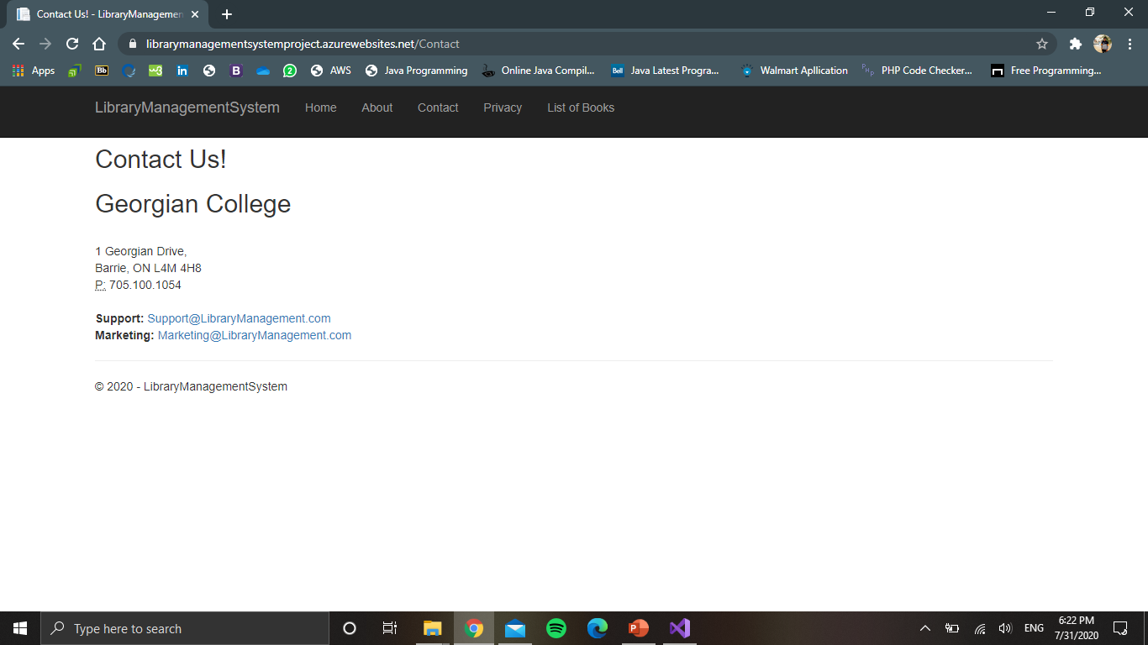
Contact Page

Slide 28
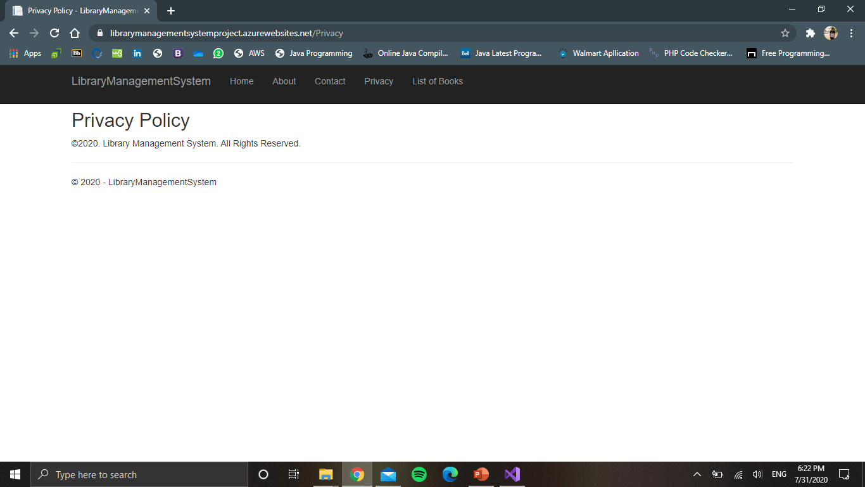
Privacy Page

Slide 29
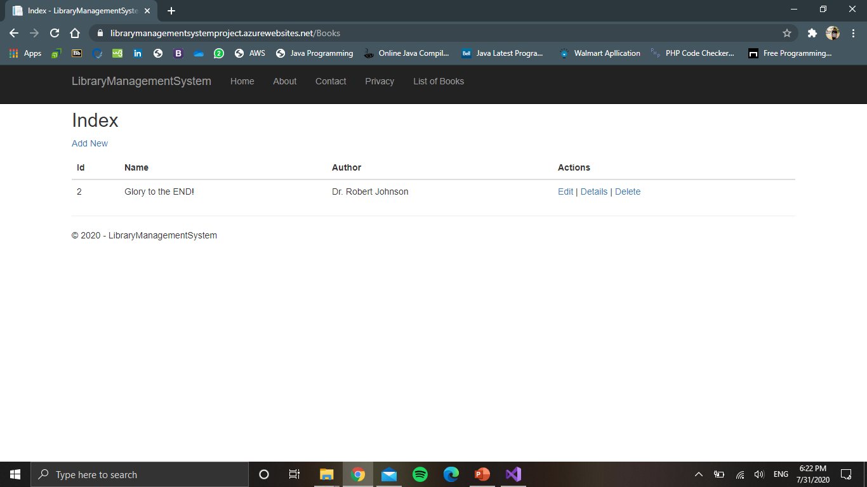
Books Page

Slide 30
Link To Our Live Web Application
Home Page:
https://librarymanagementsystemproject.azurewebsites.net/
About Page:
https://librarymanagementsystemproject.azurewebsites.net/About
Contact Page:
https://librarymanagementsystemproject.azurewebsites.net/Contact
Privacy Page:
https://librarymanagementsystemproject.azurewebsites.net/Privacy
Books Page:
https://librarymanagementsystemproject.azurewebsites.net/Books

Slide 31
Link to GitHub Repository
https://github.com/maitravpatel/LibraryManagementSystem-CSharp

Slide 32
Link to Our Presentation Video
https://drive.google.com/drive/folders/135FHNqtgR1txSsi7Z53GiI_3uYidwyNb?usp=sharing

Slide 33
Reference:
https://docs.microsoft.com/en-us/visualstudio/get-started/csharp/tutorial-aspnet-core-ef-step-02?view=vs-2019
Visual Studio
Microsoft Azure

Slide 34

Thank You!
Regards.
Maitra Patel
Kaushal Virani
Mohpreet Kaur

